Slide 1
Pricing
Lecture 7

Slide 2
Pricing Product: Understanding & Capturing Value
Chapter 10

Slide 3
Learning Objectives
10.1 Answer the question “What is a price?” and discuss the importance of pricing in today’s fast-changing environment.
10.2 Identify the three major pricing strategies and discuss the importance of understanding customer-value perceptions, company costs, and competitor strategies when setting prices.
10.3 Identify and define the other important external and internal factors affecting a firm’s pricing decisions.

Slide 4

What Is a Price? LO10.1 Answer the question “What is a price?” and discuss the importance of pricing in today’s fast-changing environment.
Price is the amount of money charged for a product or service, or the sum of all the values that customers exchange for the benefits of having or using the product or service.

Slide 5
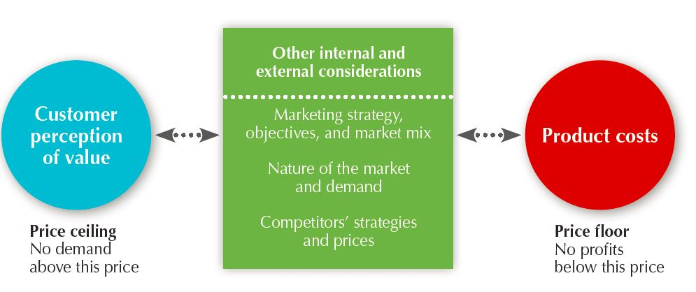
Major Pricing Strategies LO10.2 Major pricing strategies
Identify the three major pricing strategies and discuss the importance of understanding customer-value perceptions, company costs, and competitor strategies when setting prices.
Customer value-based pricing
Cost-based pricing
Competition-based pricing

Slide 6
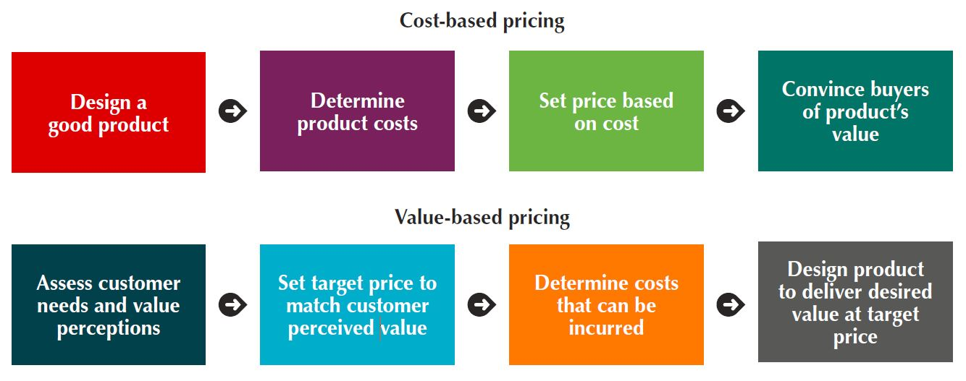
Major Pricing Strategies
Customer Value-Based Pricing
Value-based pricing uses the buyers’ perceptions of value rather than the seller’s cost.
Value-based pricing is customer driven.
Cost-based pricing is product driven.
Price is set to match perceived value.

Slide 7
Major Pricing Strategies
Customer Value-Based Pricing
Good-value pricing is offering just the right combination of quality and good service at a fair price.
Everyday low pricing (EDLP) involves charging a constant everyday low price with few or no temporary price discounts.
High-low pricing involves charging higher prices on an everyday basis but running frequent promotions to lower prices temporarily on selected items.
Value-added pricing attaches value-added features and services to differentiate the companies offers and thus their higher prices.

Slide 8
Major Pricing Strategies
Cost-Based Pricing
Cost-based pricing sets prices based on the costs for producing, distributing, and selling the product plus a fair rate of return for effort and risk.
Fixed costs are the costs that do not vary with production or sales level.
Rent
Heat
Interest
Executive salaries
Variable costs vary directly with the level of production.
Raw materials
Packaging
Total costs are the sum of the fixed and variable costs for any given level of production.
Notes:
Whereas customer-value perceptions set the price ceiling, costs set the floor for the price that the company can charge.
Some companies, such as AirAsia, Carrefour, and Dell, work to become the low-cost producers in their industries. Companies with lower costs can set lower prices that result in smaller margins but greater sales and profits. However, other companies—such as Apple and BMW—intentionally pay higher costs so that they can add value and claim higher prices and margins.

Slide 9
Major Pricing Strategies
Cost-Based Pricing
Cost-plus pricing adds a standard markup to the cost of the product.
Benefits
Sellers are certain about costs.
Price competition is minimized.
Buyers feel it is fair.
Disadvantages
Ignores demand and competitor prices

Slide 10
Cost-Plus Pricing (example – simple straightforward calculation)
Fixed Costs (FC) = $300,000
Variable Costs (VC) = $10
Expected unit sales = 50,000
Unit Cost = VC + FC/Unit Sales = 10 + (300,000/50,000) = $16
If manufacturer wants to earn 20 percent markup on sales, how much to set the markup price?
Markup price = UC/(1 – desired return on sales) = 16/(1 – 0.2) = $20

Slide 11
Major Pricing Strategies
Cost-Based Pricing
Break-even pricing (target return pricing) is setting price to break even on costs or to make a target return.
Simple Calculation (example)
Fixed Cost (FC) = $300,000
Variable Cost (VC) = $10 per unit
Selling Price (P) = $20 per unit
Break-even volume = FC/ (P – VC)
= 300,000/(20-10) = 30,000 units

Slide 12
Major Pricing Strategies
Competition-based pricing is setting prices based on competitors’ strategies, costs, prices, and market offerings.
In assessing competitors’ pricing strategies, the company should ask:
How does the company’s market offering compare with competitors’ offerings in terms of customer value?
How strong are current competitors and what are their current pricing strategies?

Slide 13
Pricing Strategies
Chapter 11

Slide 14

Learning Objectives
11.1 Describe the major strategies for pricing new products.
11.2 Explain how companies find a set of prices that maximizes the profits from the total product mix.
11.3 Discuss how companies adjust their prices to take into account different types of customers and situations.
11.4 Discuss the key issues related to initiating and responding to price changes.

Slide 15
New Product Pricing Strategies LO11.1 Describe the major strategies for pricing new products.
Market-Skimming Pricing
Market-skimming pricing strategy sets high initial prices to “skim” revenue layers from the market.
Product quality and image must support the price.
Buyers must want the product at the price.
Market-Penetration Pricing
Market-penetration pricing involves setting a low price for a new product in order to attract a large number of buyers and a large market share.

Slide 16

Product Mix Pricing Strategies LO11.2 Explain how companies find a set of prices that maximizes the profits from the total product mix.
Product line pricing
Optional product pricing
Captive product pricing
By-product pricing
Product bundle pricing
Notes:
The strategy for setting a product’s price often has to be changed when the product is part of a product mix. In this case, the firm looks for a set of prices that maximizes its profits on the total product mix. Pricing is difficult because the various products have related demands and costs and face different degrees of competition.

Slide 17
Product Mix Pricing Strategies
Product Line and Optional Product Pricing
Product line pricing takes into account the cost differences between products in the line, customer evaluations of their features, and competitors’ prices.
Optional product pricing takes into account optional or accessory products along with the main product.
Captive product pricing sets prices of products that must be used along with the main product.

Slide 18
Product Mix Pricing Strategies
By-Product and Product Bundle Pricing
By-product pricing sets a price for by-products in order to make the main product’s price more competitive.
Product bundle pricing combines several products at a reduced price.

Slide 19
Price Adjustment Strategies LO11.3 Discuss how companies adjust their prices to take into account different types of customers and situations.
Strategy | Description
Discount and allowance pricing | Reducing prices to reward customer responses such as volume purchases, paying early, or promoting the product
Segmented pricing | Adjusting prices to allow for differences in customers, products, or locations
Psychological pricing | Adjusting prices for psychological effect
Promotional pricing | Temporarily reducing prices to spur short-run sales
Geographical pricing | Adjusting prices to account for the geographic location of customers
Dynamic pricing | Adjusting prices continually to meet the characteristics and needs of individual customers and situations
International pricing | Adjusting prices for international markets
Discount and allowance pricing
Segmented pricing
Psychological pricing
Promotional pricing
Geographical pricing
Dynamic pricing
International pricing

Slide 20
Price Adjustment Strategies
Discount and Allowance Pricing
Discount and allowance pricing reduces prices to reward customer responses such as making volume purchases, paying early, or promoting the product.

Slide 21
Price Adjustment Strategies
Segmented Pricing
Segmented pricing involves selling a product or service at two or more prices, where the difference in prices is not based on differences in costs.
Customer-segment pricing
Product-form pricing
Location-based pricing
Time-based pricing
Segmented Pricing
For segmented pricing to be effective:
Market must be segmentable
Segments must show different degrees of demand
Costs of segmenting cannot exceed the extra revenue
Must be legal
Notes:
Segmented pricing takes several forms.
Under customer-segment pricing, different customers pay different prices for the same product or service. Museums and movie theaters, for example, may charge a lower admission for students and senior citizens.
Under product-form pricing, different versions of the product are priced differently but not according to differences in their costs.
Using location-based pricing, a company charges different prices for different locations, even though the cost of offering each location is the same. For instance, state universities charge higher tuition for out-of-state students, and theaters vary their seat prices because of audience preferences for certain locations.
Finally, using time-based pricing, a firm varies its price by the season, the month, the day, and even the hour. For example, movie theaters charge matinee pricing during the daytime, and resorts give weekend and seasonal discounts.

Slide 22
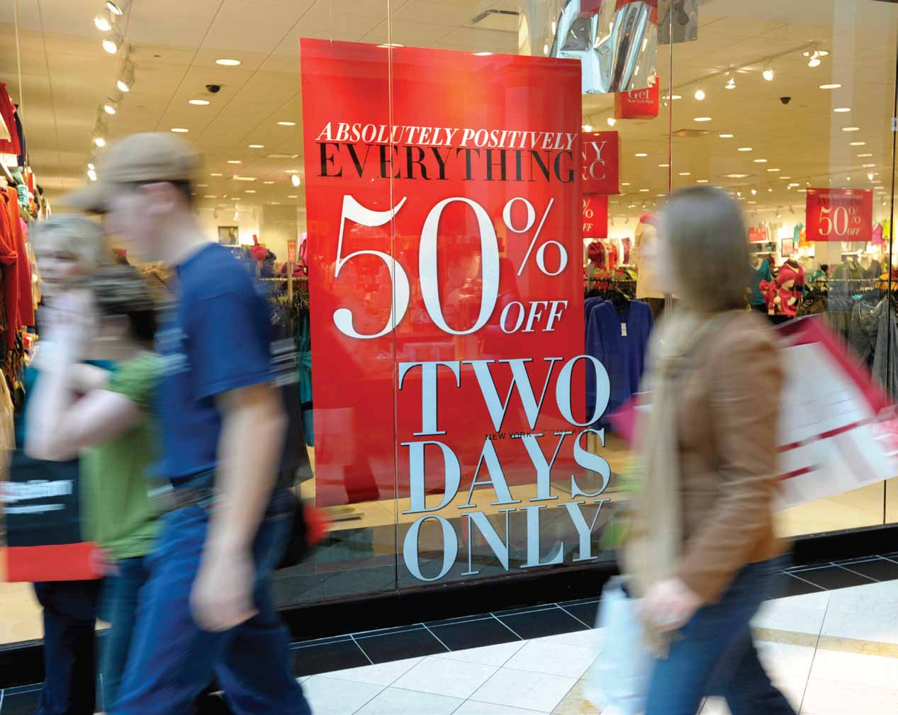
Price Adjustment Strategies
Psychological Pricing
Psychological pricing considers the psychology of prices and not simply the economics; the price is used to say something about the product.
Reference prices are prices that buyers carry in their minds and refer to when they look at a given product.
Promotional Pricing
Promotional pricing is temporarily pricing products below the list price, and sometimes even below cost, to increase short-run sales.

Slide 23
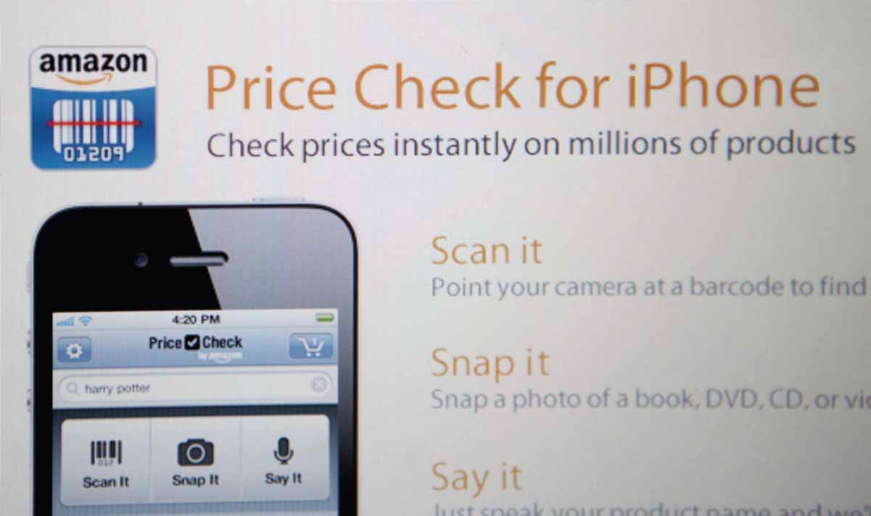
Price Adjustment Strategies
Geographical Pricing
Geographical pricing is used for customers in different parts of the country or the world.
Dynamic and Internet Pricing
Dynamic pricing involves adjusting prices continually to meet the characteristics and needs of individual customers and situations.
Notes:
Dynamic pricing: Kohl’s and many other retailers are now using digital price tags that allow them to quickly adjust prices on individual items based on competitive and other market requirements.
Today, most companies use fixed price policies—setting one price for all buyers. However, some companies are now reversing the fixed pricing trend and are now using dynamic pricing.
Dynamic pricing is especially prevalent online. Services ranging from airlines and hotels to sports teams change prices on the fly according to changes in demand or costs, adjusting what they charge for specific items on a day-by-day or even hour-by-hour basis
Also thanks to the Internet, consumers can get instant product and price comparisons from thousands of vendors at price comparison sites and armed with this information, consumers can often negotiate better in-store prices.
In fact, many retailers are finding that ready online access to comparison prices is giving consumers too much of an edge. Store retailers are now devising dynamic pricing strategies to combat the consumer practice of showrooming, comparing prices online while in the store, and then buying the item online at a lower price.

Slide 24
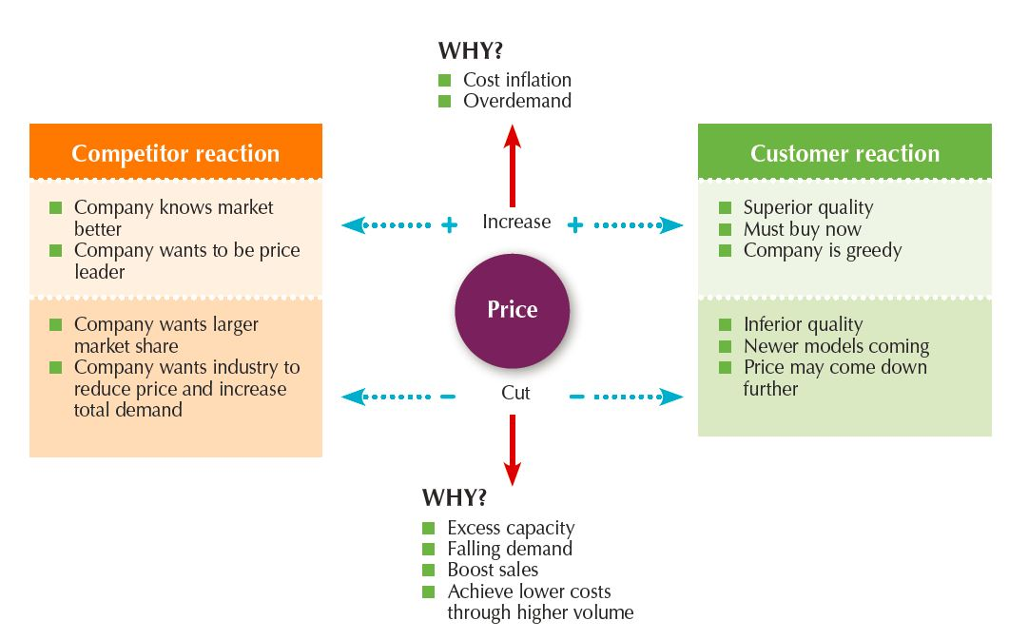
Price Changes LO11.4 Discuss the key issues related to initiating and responding to price changes.
Initiating Pricing Changes
Price cuts occur due to:
Excess capacity
Increased market share
Price increases occur due to:
Cost inflation
Increased demand
Lack of supply

Slide 25
Price Changes
Buyer Reactions to Pricing Changes
Price increases
Product is “hot”
Company greed
Price cuts
New models will be available
Models are not selling well
Quality issues
Competitor Reactions to Pricing Changes
Why did the competitor change the price?
Is the price cut permanent or temporary?
Is the company trying to grab market share?
Is the company doing poorly and trying to increase sales?
Is it a signal to decrease industry prices to stimulate demand?

Slide 26
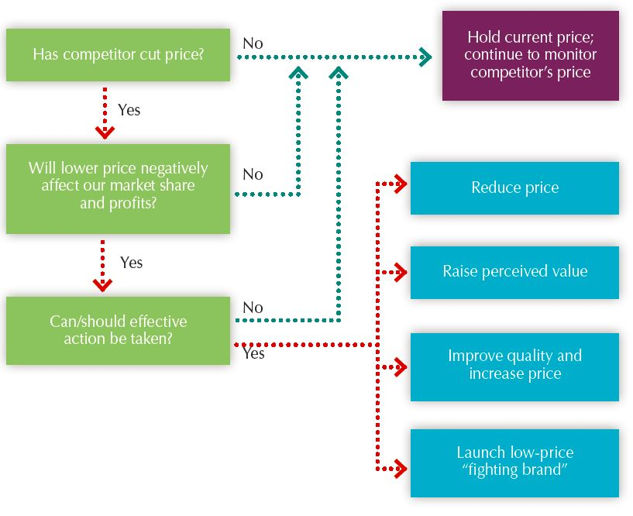
Price Changes
Responding to Price Changes
Effective Action Responses
Reduce price to match competition
Maintain price but raise the perceived value through communications
Improve quality and increase price
Launch a lower-price “fighting” brand

